Slide 1
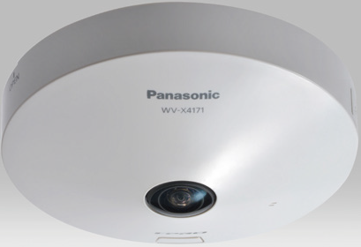
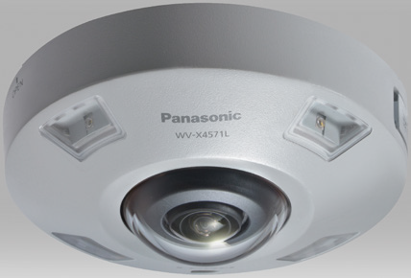
9Megapixel 360-degree Camera for SE ver.2.00
Model: WV-X4171/X4170 (Indoor)
WV-X4571L/X4571LM (Outdoor Vandal)
23rd Feb. 2018
Panasonic Corporation
Notes:
摂氏→華氏 F=(9/5)*C + 32
華氏→摂氏 C=(5/9)*(F-32)

Slide 2
Welcome & Disclaimer
This document, Ver. 2.00, is updated from previous Ver.1.00.
Hence some of the specification & function detail might be changed without announcement.
This document is not cover all over about the product. Therefore, please utilize this document together with other materials such as “Installation Guide”, “Operating Instructions”, “Quick Reference Guide” “Specification Sheet” and “Product Presentation Material” so on as necessary.
These materials can be downloaded from the following website.
http://security.panasonic.com/download/
2

Slide 3
Version History
No | Update contents | Page No. | Version | Editor | Update
- | 1st Version |  | Ver.1.00 | A. Yamani | 9.Feb.2018
1 | Add typical GUI image | 64-81 | Ver.2.00 | A. Yamani | 23.Feb.2018
3
Notes:
288kmph= カトリーナ：280 km/h
伊勢湾台風=270km/h

Slide 4
Contents
Concept
Key features
      Extreme Visibility
      Extreme Compression
Image Capture mode
Supported Resolution
System Configuration
Specification Comparison
Bundled Items and Options
Model Number
Appearance
      Extreme Data Security
      Extreme Simplicity
      Other Features
4

Slide 5
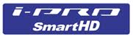

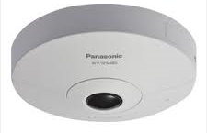
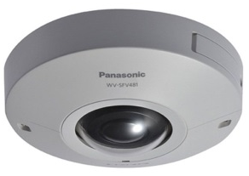
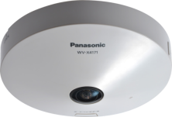
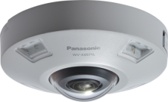
Product Concept
WV-X4171/X4571L will be launched as a successor to WV-SFN480/SFV481.
New Line-up of i-PRO Extreme series camera
Support H.265 codec
H.264
H.265
Existing 9M 360-deg. camera
New 9M 360-deg. camera
WV-SFN480
WV-SFV481
WV-X4171/X4170
WV-X4571L/X4571LM
X4171
X4571L
X4170
X4571LM
5

Slide 6
Product Concept
Industry's best peripheral resolution and compression performance
Focus Point
Needs
Solution
Appeal Point
EXTREME
Visibility
Covering Wide Variety Reduce
and Number of Cameras
Face recognition distance: 6m
Super Dynamic range: 108dB
Coverage in the Night: 10m
Face visibility of a moving person: No.1 in industry
Good peripheral resolution by stereo projection lens
Improved Wide dynamic Range by 108dB (SFN480/SFV481: 84dB)
Built in IR-LED : Max. 10m Reach distance (only WV-X4571L)
Provide best image by “Intelligent Auto (iA)”
Support Various dewarp mode (as same as Current 9M360 deg. Camera)
EXTREME Compression
Long term recording
NW stress reduction
Enables to reduce bitrate by H.265 codec and new Smart Coding feature, “Frame rate control”
Reduce data size with the same image quality
EXTREME
Data Security
Protect Image Data from the hacking
FIPS140-2 (Industry first)
Cost saving for certificate
Provide High secure system by Symantec certificate
EXTREME
Simplicity
Improve Monitoring Efficiency
People counting, Heat-map and MOR
New People counting
Support Intelligent Functions * Required Optional License
X4171
X4571L
X4170
X4571LM
6

Slide 7
Key Features
Extreme Visibility
  Peripheral Resolution by Stereo projection lens
  Super Dynamic 108dB
  Built in IR-LED supports 10m (only WV-X4571L)
  iA (intelligent Auto)
  Support Various dewarp mode (as same as current 9M 360 deg. Camera)
Extreme Compression
  H.265 + Smart Coding
Extreme Data Security
  Secure communication by Symantec certificate
  FIPS 140-2 Level 1 compliant
Extreme Analytics
  New People Counting * ASE303W
  People Counting, Heat-map and MOR * SAE200
New 9M 360-deg. camera
WV-X4171/X4170
(Indoor)
WV-X4571L/X4171LM
(Outdoor Vandal with IR-LED)
Other Features
  IP66, IK10 support *WV-X4571L (Vandal Resistant Outdoor model)
  Anti-corrosion screw
  SD card error display
  Built in Dehumidifier
7

Slide 8
Key Features
Extreme Visibility
  Peripheral Resolution by Stereo projection lens
  Super Dynamic 108dB
  Built in IR-LED supports 10m (only WV-X4571L)
  iA (intelligent Auto)
  Support Various dewarp mode (as same as current 9M 360 deg. Camera)
Extreme Compression
  H.265 + Smart Coding
Extreme Data Security
  Secure communication by Symantec certificate
  FIPS 140-2 Level 1 compliant
Extreme Analytics
  New People Counting * ASE303W
  People Counting, Heat-map and MOR * SAE200
New 9M 360-deg. camera
WV-X4171/X4170
(Indoor)
WV-X4571L/X4171LM
(Outdoor Vandal with IR-LED)
Other Features
  IP66, IK10 support *WV-X4571L (Vandal Resistant Outdoor model)
  Anti-corrosion screw
  SD card error display
  Built in Dehumidifier
8
8

Slide 9
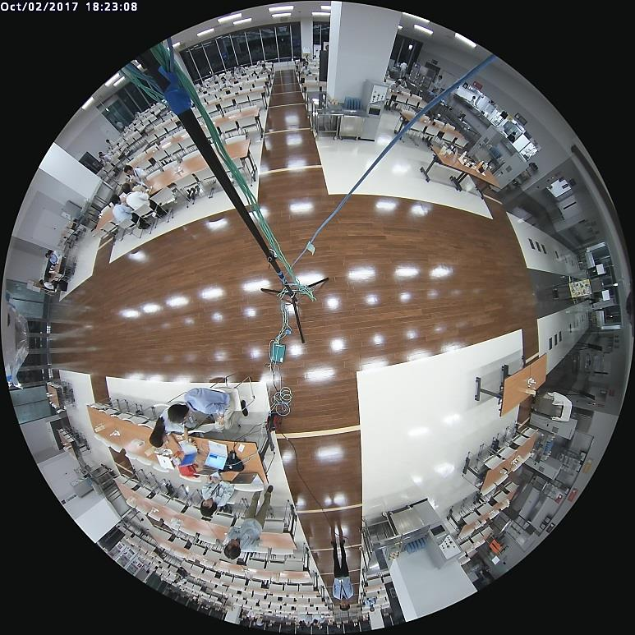



Peripheral Resolution by Stereo projection lens
Extreme
Visibility
Panasonic fisheye camera applies stereo projection lens, it enable higher resolution and lower distortion image around peripheral than normal lens.
WV-X4171 (New 9MP)
Projection Type | Peripheral resolution / image | Formula (y: image height)
Stereographic | High resolution / Low distortion
Orthogonal | Low resolution / High distortion
$$y=2∗f∗\tan{\frac{θ}{2}}$$
$$y=f∗\sin{θ}$$
9m
High Peripheral resolution and low distortion
y
A’
sensor
Low Peripheral resolution and high distortion
f
lens
θ
A
Stereographic
Orthogonal
X4171
X4571L
* Camera height: 3.0m
* Illuminance: Approx. 800lx
X4170
X4571LM
9

Slide 10
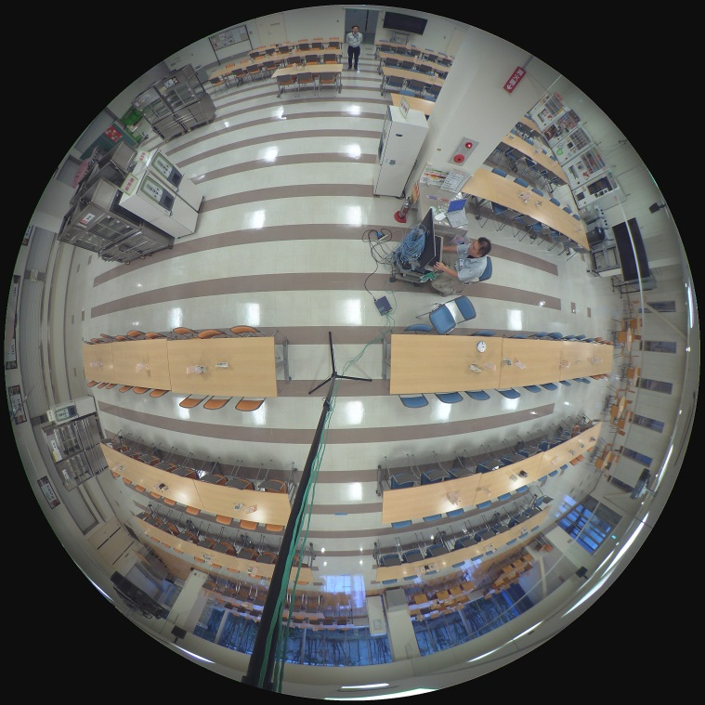
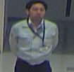
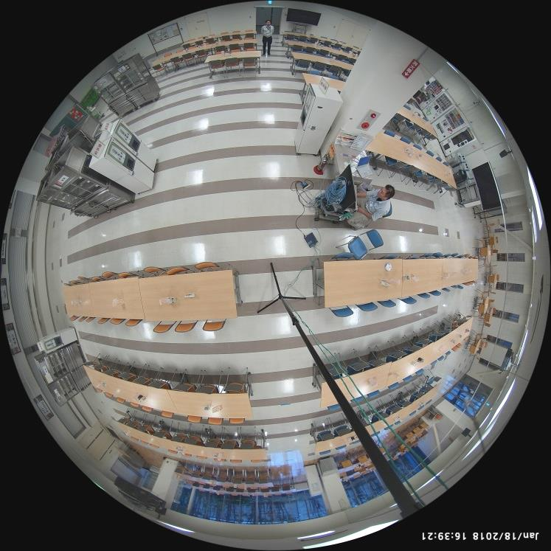
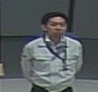
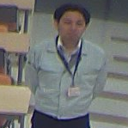
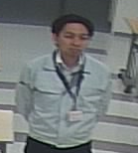
Image Comparison: Resolution of peripheral part
Extreme
Visibility
New camera can provide clear face image even 9m ahead.
WV-SFN480 (Existing 9MP)
WV-X4171 (New 9MP)
9m
9m
9m
9m
6m
6m
X4171
X4571L
* Camera height: 3.0m
* Illuminance: Approx. 800lx
X4170
X4571LM
10

Slide 11
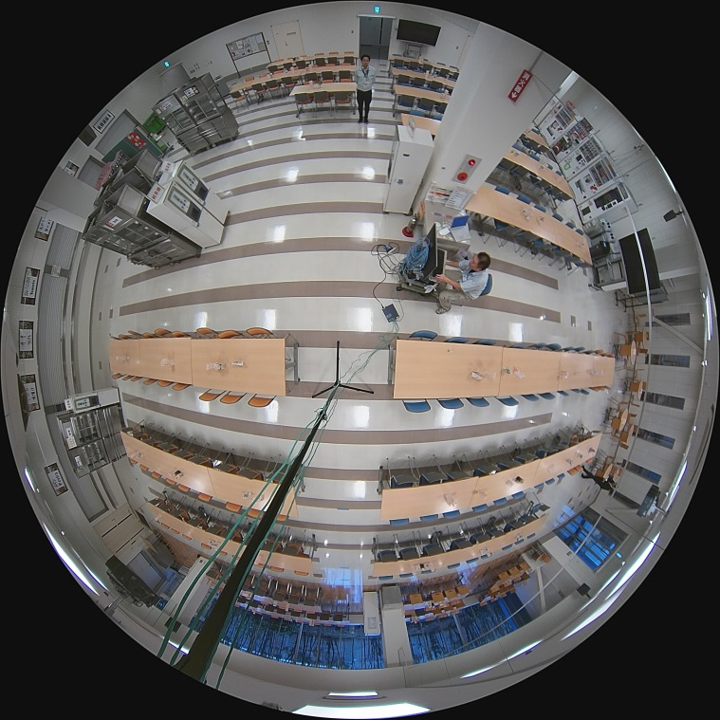
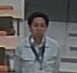
Image Comparison: Resolution of peripheral part
Extreme
Visibility
Comparison with 5M 360-deg. camera
WV-S4150 (5M 360-deg. camera)
WV-X4171 (New 9MP)
9m
9m
6m
6m
6m
6m
* Camera height: 3.0m
* Illuminance: Approx. 800lx
X4170
X4571LM
11

Slide 12
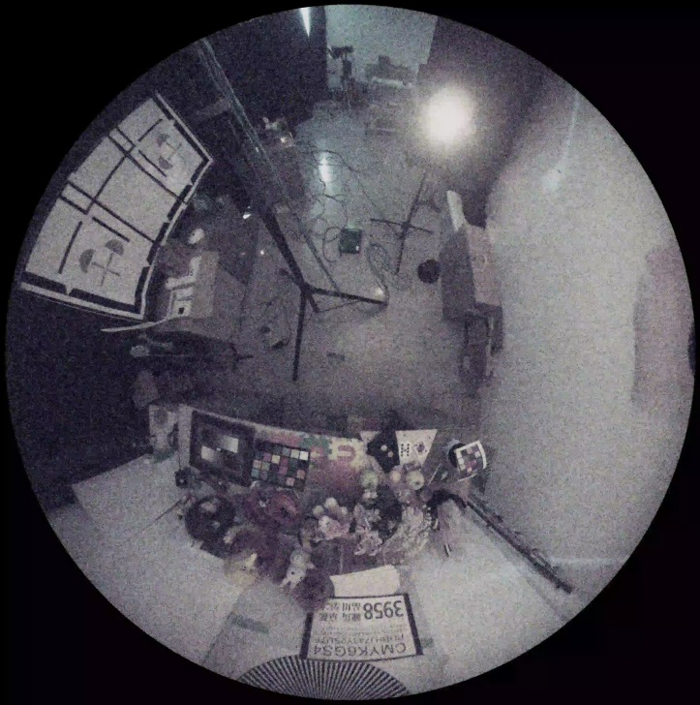
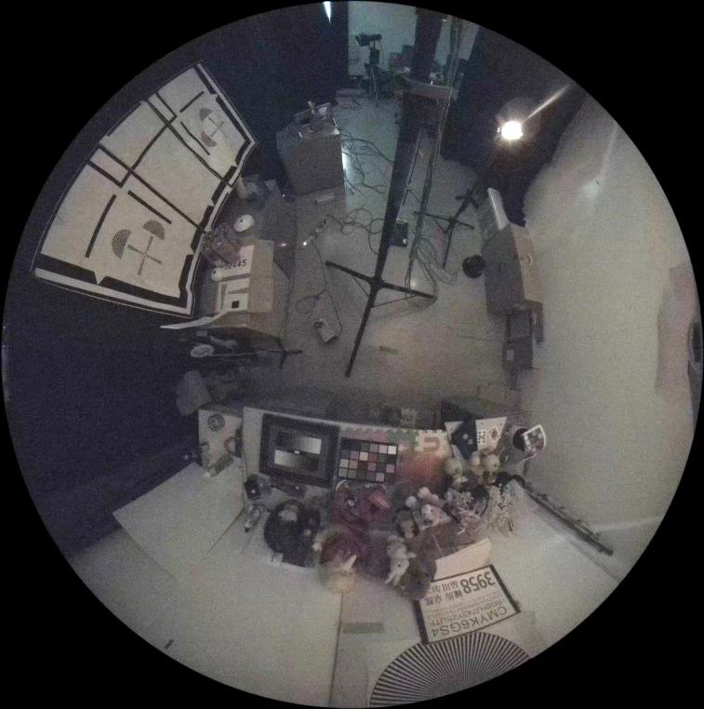


Image Comparison: Low Illuminance
Extreme
Visibility
Min. Illuminance specification is 0.3lx same as existing 9M.
WV-SFN480 (Existing model)
Min. Illuminance Specification: 0.3lx
WV-X4171 (New 9MP)
Min. Illuminance Specification: 0.3lx
X4171
X4571L
* Shooting environment: 0.5lx
X4170
X4571LM
12

Slide 13
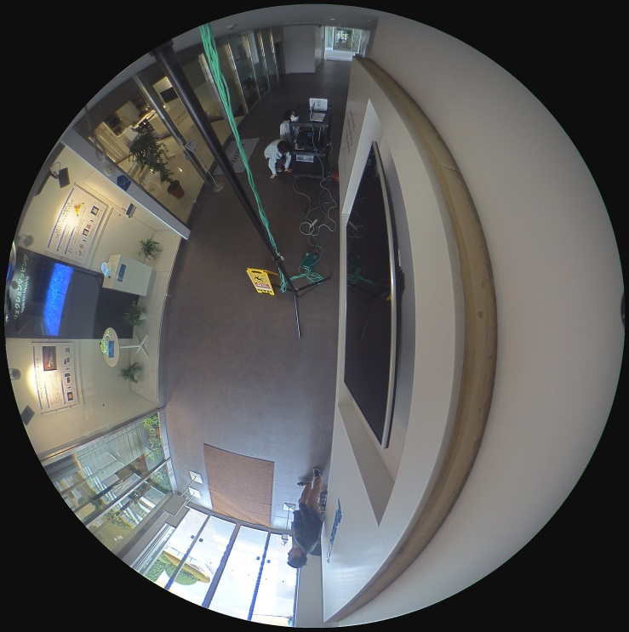
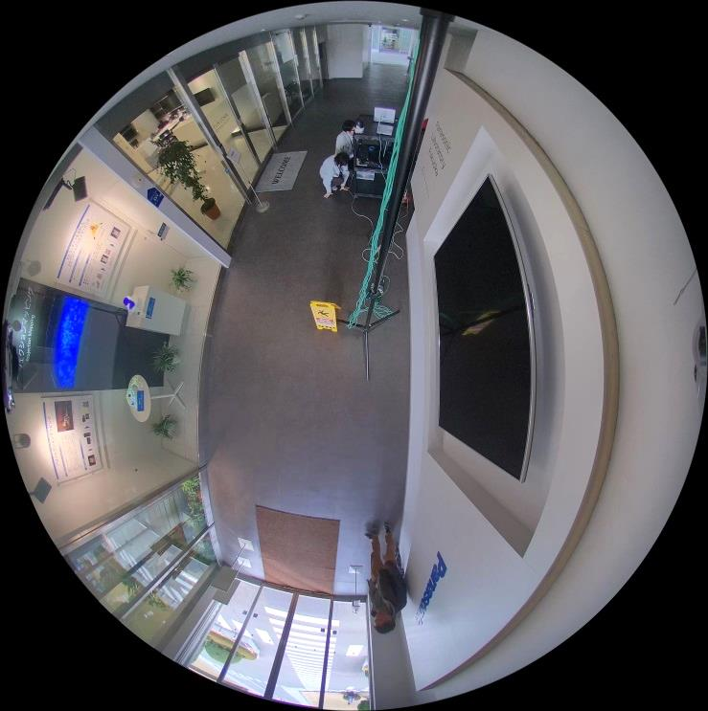
Image Comparison: Super Dynamic
Extreme
Visibility
Implement Super Dynamic: 108 dB
WV-SFN480 (Existing model)
WV-X4171 (New 9MP)
Outside the window white jump
Visible outside the window
Dynamic range: 84db (Reference)
Dynamic range: 108db
X4171
X4571L
X4170
X4571LM
13

Slide 14
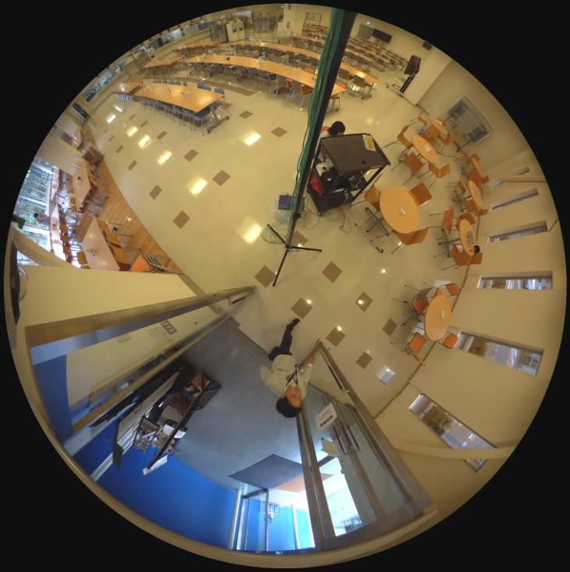
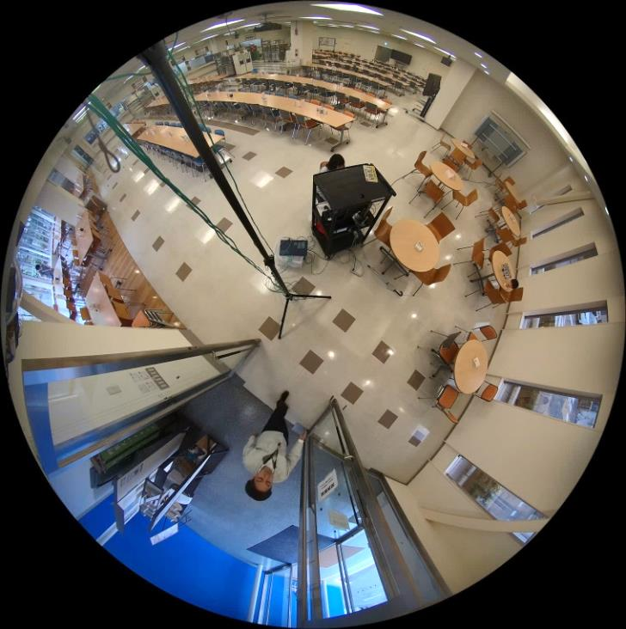
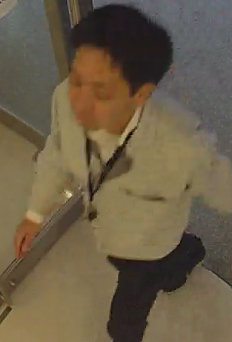
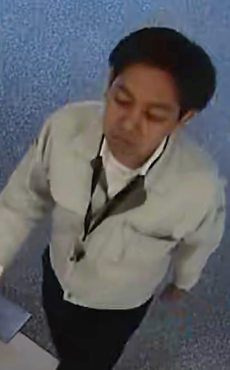
Image Comparison: iA (Intelligent Auto)
Extreme
Visibility
Automatically adjusts to the optimum image quality parameter according to the shooting scene
WV-SFN480 (Existing 9MP)
WV-X4171 (New 9MP)
X4171
X4571L
* Shooting environment: Approx. 800lx
14
X4170
X4571LM
14

Slide 15

iA (Intelligent Auto)
Extreme
Visibility
Intelligent Auto
Automatically optimizes camera parameters for best tuned image for various scenes, using techniques like Full Auto Shutter & Iris control, Backlit compensation , auto image stabilization.
It also can detect characteristics and movement within the scene to optimize camera settings to provide best fit picture quality.
OFF
ON
OFF
ON
X4171
X4571L
X4170
X4571LM
15
Notes:
Innovative Visibility
Automatically detect scenes and optimize parameter settings
to enable clear shot of the face and license plate number.
Backlit Scene
Moving Object
Show clearly by shortening the shutter speed of only moving thing.
License plate in the low light
Low light SD performance went up.

Slide 16
iA (intelligent Auto)
Extreme
Visibility
iA enables “sharper, less blur” image of moving object and “higher contrast“ facial image by changing “shutter speed” and “contrast” than normal (means iA “OFF”) mode.
iA applies stronger image effect than normal mode according to shooting object. So iA doesn’t have fixed parameter.
iA has two sub parameter, “motion priority” and “face priority”. You may change parameter but firstly, SSBD recommends to use as iA “ON” without changing any priority and to change only if they want to emphasize efficiency. Please see guideline of next slide and please understand side effect also appears if you change priority.
Since setting of SD (super dynamic) depends on suitable scene or favorite of customer, SD setting is separated from iA menu. User enables to select on or off. Even if SD is off, iA control BLC or HLC to increase contrast of face. However SSBD recommends to use SD on.
Effect of “Motion iA” is limited in case of fixed shutter mode or flicker less mode. It recommends to use as outdoor scene mode.
X4171
X4571L
X4170
X4571LM
16

Slide 17

iA (intelligent Auto): Setting Guide Line
Extreme
Visibility
Set “iA” as Default Parameter
Image is still blur
Note: “Face priority” is not applied 9MP 360 deg. camera
Countermeasure | Increase Motion priority level and check result
Effect | Value 0 : Same as normal mode Value 128: Max. 8 times faster shutter speed Value 255: Faster shutter speed than mid value
Side effect | If too fast shutter speed, S/N ratio of image becomes worse because AGC increase gain of noise. If gain level is controlled at low, image becomes dark.
X4171
X4571L
X4170
X4571LM
17
Notes:
Innovative Visibility
Automatically detect scenes and optimize parameter settings
to enable clear shot of the face and license plate number.
Backlit Scene
Moving Object
Show clearly by shortening the shutter speed of only moving thing.
License plate in the low light
Low light SD performance went up.

Slide 18
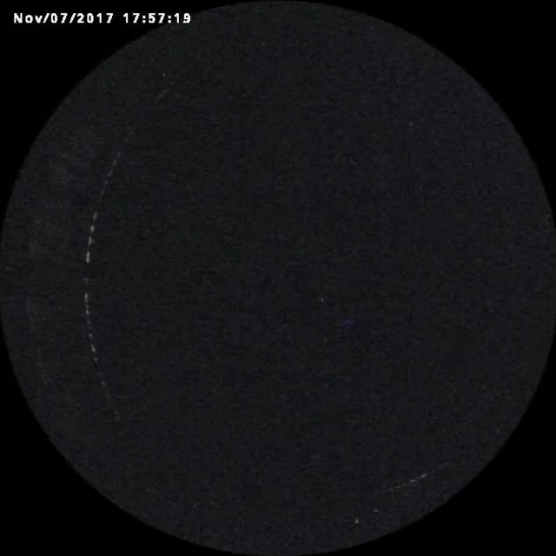
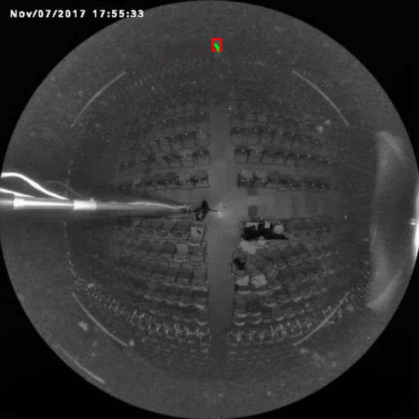
Extreme
Visibility
Intelligent Function in the Night
When using IR-LED, the intelligence function can be used if it is within the range of 10m
IR_OFF
IR_ON
Intelligent functions are not available.
Intelligent functions are available.
Maximum detection distance =10m
- IR LED light intensity : High
- Peripheral intensity control : On
Note
Intelligent functions will not effectively work in the following situations or may sometimes be malfunctioning.
• There is no difference in luminance level between the moving object and background.
• Outside light (sunlight, headlights, etc.) enters the shooting area.
• Fluorescent light is flickering.
• Weather condition is extremely poor.
• The detection area is blocked with shadows.
X4571L
X4571LM
18
Notes:
As first introduction of 4K cameras, we will launch 2 new 360 degree cameras;
One is WV-SFV481, outdoor vandal model, and the other is SFN480, indoor dome model.
The 3 major points are
ULTRA High Resolution 9M pixel as 360 degree camera
ULTRA High Sensitivity
ULTRA Intelligent

Slide 19
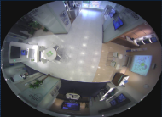







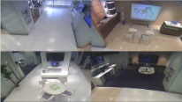



Various Image Processing
Extreme
Visibility
Support various De-warp mode by camera (as same as SFN480/SFV481)
1. Double Panorama
Displayed with distortion correction performed on a 180° image for half of a fisheye image. (2560x1440 to 320x180 selectable)
2. Panorama
Displayed with distortion correction performed on the 180° horizontal angle view part of the center of a fisheye image. (2560x1440 to 320x180 selectable)
3. Fisheye
Displayed without performing distortion correction as a fisheye image. (2992x2992 to 320x180 selectable)
4. Single PTZ
Display one specified area with electronic PTZ. Position of area to be displayed can be specified. (2560x1920~QVGA selectable)
5. Quad PTZ
Display the specified 4 areas with electronic PTZ. Position of 4 areas to be displayed can be specified. Distributed as 2 x 2 divided 1 image. (2560x1920～QVGA selectable)
6. Quad Stream
Distribute each channel of 4 PTZ separately (1280 x 960 ~ QVGA selectable) It is possible to simultaneously deliver 4 images PTZ.
Stream (1)
Stream (2)
X4171
X4571L
X4170
X4571LM
19

Slide 20
Key Features
Extreme Visibility
  Peripheral Resolution by Stereo projection lens
  Super Dynamic 108dB
  Built in IR-LED supports 10m (only WV-X4571L)
  iA (intelligent Auto)
  Support Various dewarp mode (as same as current 9M 360 deg. Camera)
Extreme Compression
  H.265 + Smart Coding
Extreme Data Security
  Secure communication by Symantec certificate
  FIPS 140-2 Level 1 compliant
Extreme Analytics
  New People Counting * ASE303W
  People Counting, Heat-map and MOR * SAE200
New 9M 360-deg. camera
WV-X4171/X4170
(Indoor)
WV-X4571L/X4171LM
(Outdoor Vandal with IR-LED)
Other Features
  IP66, IK10 support *WV-X4571L (Vandal Resistant Outdoor model)
  Anti-corrosion screw
  SD card error display
  Built in Dehumidifier
20

Slide 21
Extreme Compression: H.265 HEVC
Extreme
Compression
H.265 is next generation of video codec. After standardize, it’s now ready to apply
The 1st version of the HEVC standard was finalized in April 2013.
The 2nd version of HEVC including the RExt, SHVC and MV-HEVC extensions was finalized in October 2014.
The 3rd version of HEVC including the 3D-HEVC extension was finalized in February 2015.
2010 | 2011 | 2012 | 2013 | 2014 | 2015 | 2016
April
HEVC ver.1 Standard
Format Range Extension (RExt)
OCT
- Main Profile (4:2:0 8bit)
→ Equivalent to
H.264 Main/High Profile
- Main10 Profile (4:2:0 10bit)
→ 4:2:0 10bit
- Main Still Profile
HEVC Profile Extension
Scalability Extension (SHVC)
HEVC SVC Extension
Multiview Extension(MV-HEVC)
HEVC MV Extension
3D Extension(3D-HEVC)
Feb
HEVC 3D Extension
Screen Content Coding Extension(SCC)
Feb
HEVC SCC Extension
X4171
X4571L
X4170
X4571LM
21

Slide 22
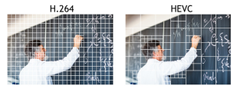
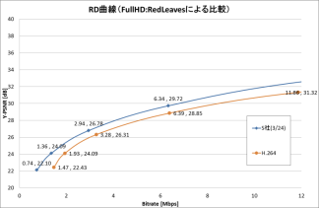

Extreme Compression: H.265 HEVC
Extreme
Compression
H.265 improve encoding efficiency more than H.264. It reduces bitrate by 50% compared H.264 (legacy and other competitor) and 30% compared Panasonic latest H.264 camera.
 | H.264/AVC | H.265/HEVC | 効果
Coding tree unit | 16x16 | 8x8, 16x16, 32x32, 64x64 | High efficiency of Encoding
prediction blocks | 4x4–16x16 unit | 4x4-64x64 unit
Transform | 4x4, 8x8 DCT | 4x4-32x32 DCT, 4x4 DST
Quantization | 4x4, 8x8 quantization matrix | 4x4-32x32 quantization matrix
Intra-prediction | 8direction + DC | 33direction + DC + Planer | High accuracy of prediction
inter-picture prediction | -interpolation with an 6-tap filter -motion vector prediction (one candidate) | -interpolation with an 8-tap filter -motion vector prediction (many candidate)
Loop filters | De-blocking filter | De-blocking filter Sample Adaptive Offset(SAO) | Decoded image quality improvement
Entropy coding | CABAC CAVLC | CABAC | High efficiency of Encoding
HEVC apply large prediction block for plane area. This educes number of block and save total data size
RD curve (relation with image quality and bitrate)
RD curve is one of the subjective evaluation method of image quality.
According to encoding test by using official video clip, we can save 30%. (Generally 50%)
Panasonic H.265
Panasonic H.264 (latest codec)
1.36/1.93≒70%
(30% reduced)
X4171
X4571L
X4170
X4571LM
22

Slide 23
Smart Coding
Extreme
Compression
WV-X4171/X4571L camera enhances smart coding technology by applying “New Control Mode”.
Smart coding Technology | WV-S4150/S4550L
Encoding load Reduction | GOP control Apply long term P frame in advanced mode: I-Frame interval is fixed every 60sec but long term P frame which enables to create image with only previous I-frame is inserted every 1 sec.
 | Frame rate control （NEW） Control the frame rate with / without motion, it is the installation value in the case of motion, and in the case of no motion it drops from the set value Available Transmission Priority: VBR mode only
 | AUTO VIQS Improved image quality by low pass filter
Support Transmission mode | GOP : Low / Mid / Advanced mode: VBR : Advanced mode: Constant bit rate, Frame rate and Best Effort AUTO VIQS : all transmission type
Support Stream | Stream 1-2 1st stream: GOP and AUTO VIQS 2nd stream: GOP only
X4171
X4571L
X4170
X4571LM
23

Slide 24

Smart Coding – Frame Rate Control (New)
Extreme
Compression
Frame rate control
Different type of GOP is applied at motion and no motion.
If there is no motion, camera reduces frame rate gradually and finally it reaches 1fps. This means max. i-frame interval becomes 480sec.
GOP @Motion
GOP @No motion
i-frame
i-frame
GOP type | Motion | No motion
I-frame interval | 4s | 16s to (FPS* 16) s (increase gradually) (16s to 480s @ 30fps)
Number of frames of GOP | FPS * 4 (120@30fps) | FPS * 16 (480 @30fps)
Frame Rate | Keep frame rate setting | Reduced frame rate and reach 1fps
P P P
P P P
P P P
Extend GOP
Like bellows
120 frames@30fps
480 frames@30fps
Extend time scale
With keeping same number of frame
No motion
30fps
16s
32s
64s
160s
480s
30fps
15fps
7.5fps
1/3sec
3fps
1fps
1sec
0s
16s
48s
112s
272s
752s
Motion
No Motion
X4171
X4571L
X4170
X4571LM
24

Slide 25
Smart Coding – Frame Rate Control (New)
Extreme
Compression
Frame rate control
By dynamically controlling the frame rate in addition to the refresh interval depending on the presence or absence of motion, the bit rate at the time of scene shooting without motion is further reduced.
Pattern 1: Without Motion all the time
(Example: In case of Frame rate = 30fps)
Without Motion
Depending on the situation, the frame rate drops.
It will drop to 1 fps as maximum.
When 1 fps, the I frame interval becomes 480s.
The frame rate and I frame interval will be changed as a set, such as 30fps/16s, 15fps/32s, 7.5fps/64s, 3fps/160s and 1fps/480s.
i-frame
i-frame
i-frame
i-frame
i-frame
i-frame
P P P
P P P
P P P
・ ・ ・ ・ ・ ・ ・ ・
P P P
P P P
P P P
P P P
P P P
P P P
P P P
・ ・
・ ・ ・ ・ ・ ・ ・ ・ ・ ・ ・
・ ・ ・ ・ ・ ・ ・ ・ ・ ・ ・
・ ・ ・ ・ ・ ・ ・ ・ ・ ・ ・
30fps
16s
15fps
32s
7.5fps
64s
3fps
160s
1fps
480s
Pattern 2: Motion restoration
Motion detected
No Motion again
When motion is detected, frame rate will be increased up to 30fos (In case of Frame rate = 30 fps)
I frame interval will be changed between 4s and 16s depend on the situation whether there is motion.
When there is no more motion again, the operation of above Pattern 1 is repeated.
Without Motion
With Motion
Without Motion
i-frame
i-frame
i-frame
i-frame
i-frame
i-frame
P P P
P P P
P P P
・ ・ ・ ・ ・ ・ ・
P P P
P P P
P P P
P P P
P P P
P P P
P P P
P P P
・ ・ ・ ・ ・ ・ ・ ・
P P P
・ ・ ・ ・ ・ ・ ・ ・ ・ ・ ・
・ ・
・ ・
・ ・
1fps
480s
1fps
30fps
4s
30fps
4s
30fps
16s
15fps
32s
X4171
X4571L
X4170
X4571LM
25

Slide 26
Smart coding
Extreme
Compression
Frame rate control mode is newly added same as 5M 360-deg. Camera.
Smart Facial coding is not supported.
 | GOP control |  | Auto-VIQS | Smart Facial Coding
H.264 Mode | OFF | - | -
 | Low | I frame interval: 1 sec to 8 sec | - | N/A
 | Mid | I frame interval: 4 sec to 16 sec | - | N/A
H.265 Mode | OFF | - | -
 | Low | I frame interval: 1 sec to 8 sec | OFF | N/A
 |  |  | ON | N/A
 | Mid | I frame interval: 4 sec to 16 sec | OFF | N/A
 |  |  | ON | N/A
 | Advanced | I frame interval: 60 sec | OFF | N/A
 |  |  | ON | N/A
 | Frame rate control | I frame interval / Frame rate Motion : 4 sec No Motion：16sec/[FPS] ~ [FPS*16]sec/1fps (@30fps, 16sec/30fps ~ 480sec/1fps) | OFF | N/A
 |  |  | ON | N/A
X4171
X4571L
X4170
X4571LM
26

Slide 27
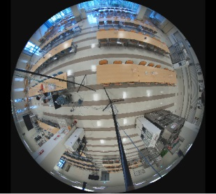
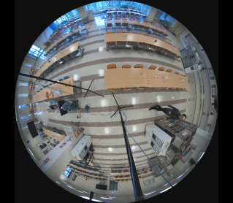
Extreme Compression : Smart coding (H.265 mode)
Extreme
Compression
Below is one of the reference “Sample measured” result of smart coding.
Result may change on actual environment, light condition and frequency of motion.
Scene | Smart Coding | I frame interval | Auto-VIQS | Bitrate (kbps)
No motion | OFF | 1sec | OFF | 4198
 | MID | 16sec | OFF | 1052
 |  |  | ON | 224
 | Advanced | 60sec | OFF | 335
 |  |  | ON | 295
 | Frame Rate Control | 480sec with 1fps | OFF | 19
 |  |  | ON | 8
Scene | Smart Coding | I frame interval | Auto-VIQS | Bitrate (kbps)
With Motion | OFF | 1sec | OFF | 8120
 | MID | 4sec (to 16sec) | OFF | 5344
 |  |  | ON | 737
 | Advanced | 60sec | OFF | 956
 |  |  | ON | 387
 | Frame Rate Control | 4sec with 30fps | Same as “MID” with motion
X4171
X4571L
X4170
X4571LM
27

Slide 28
Key Features
Extreme Visibility
  Peripheral Resolution by Stereo projection lens
  Super Dynamic 108dB
  Built in IR-LED supports 10m (only WV-X4571L)
  iA (intelligent Auto)
  Support Various dewarp mode (as same as current 9M 360 deg. Camera)
Extreme Compression
  H.265 + Smart Coding
Extreme Data Security
  Secure communication by Symantec certificate
  FIPS 140-2 Level 1 compliant
Extreme Analytics
  New People Counting * ASE303W
  People Counting, Heat-map and MOR * SAE200
New 9M 360-deg. camera
WV-X4171/X4170
(Indoor)
WV-X4571L/X4171LM
(Outdoor Vandal with IR-LED)
Other Features
  IP66, IK10 support *WV-X4571L (Vandal Resistant Outdoor model)
  Anti-corrosion screw
  SD card error display
  Built in Dehumidifier
28

Slide 29
Secure Communication
Extreme
Data Security
Pre-installed certification by Symantec and latest technology for SSL & data encryption realize
“highly secured communication system”
 | Symantec certification | AES 256bit Encryption | Secret Sharing Scheme | Supported devices
 |  |  |  | i-PRO System | VI | Other VMS
SSL communication |  |  |  |  (between camera, NX series NVR and ASM300) |  |  *limited
Data encryption | - |  |  |  (SD card recording) (between camera and NX series NVR) (between camera and ASM300 *NX series NVR is necessary) (between NX series NVR and ASM300) | N/A | N/A
Device certificate (*Future function) |  | - | - |  (only between camera and NX series NVR) | N/A | N/A
Alteration Detection |  | - | - |  (with tool) | N/A | N/A
Pre-installed certification of Symantec realizes high reliability for SSL communication and high secured device certification*
Encryption module of SSL meets FIPS 140-2 Level1 (CAVP), which is U.S. government computer security standard
Encryption of SSL and data encryption support latest “AES-256bit key” strong encryption (usually used 128bit long key)
Continuous Vulnerability Test contributes to find latest security risk and take measure against risk quickly
Panasonic applies secret sharing scheme to save resources of data encryption
When using secure communication function with NX series NVR, optional license will be required.
* Detailed information are explained in Secure material for SE
X4171
X4571L
X4170
X4571LM
29

Slide 30
Secure Communication: Data encryption
Extreme
Data Security
Generally, data encryption requires a lot of memory and CPU resources for encryption and decryption.
By applying “Secret Sharing Scheme” before encryption,
Panasonic enables to reduce the amount of encrypted data and save resource.
■H.264 (1Frame)
Secret sharing scheme is to separate secret data into parts and keep those parts separately to enhance security of saving data.
Data is possible to restore only if all parts are collected. Even one missing part disables to restore original data.
By using this scheme, Panasonic encrypts only one part of data and contribute to reduce device resources.
AUD
SPS
PPS
SEI
SEI
NAL
Picture Data
Secret Sharing Technology
9 : 1
Sharing Data
Sharing Data
Data encryption by AES 256bit key
■Encrypted H.264 (1Frame)
AUD
SPS
PPS
SEI
SEI
NAL
Sharing Data ⑨
AES
Note: “Data encryption” will be supported from next version up
* Detailed information are explained in Secure material for SE
X4171
X4571L
X4170
X4571LM
30

Slide 31
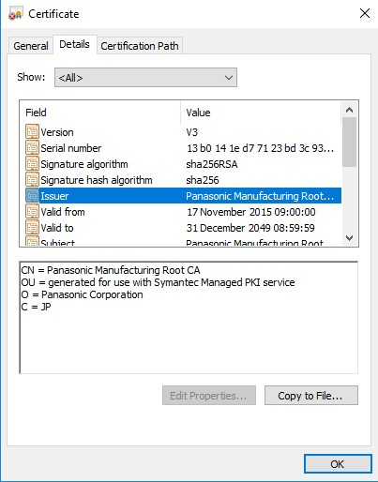
Secure Communication
Extreme
Data Security
Why Symantec?
Symantec certification is pre-installed into hardware of i-PRO cameras at factory.
  No need to install certification manually
  Someone doesn’t able to re-write and remove certification
Symantec issues reliable certification for i-PRO cameras
  It is certified by reliable organization “Symantec”
  Much more reliable than self-certification as competitor
Why Panasonic SSL is reliable?
There are a lot of vulnerability report related to Open SSL,
on the other hand, Panasonic has in-house encryption module.
* Detailed information are explained in Secure material for SE
X4171
X4571L
X4170
X4571LM
31

Slide 32
Camera Limitation of SSL and Data encryption
Extreme
Data Security
Max total camera bandwidth will be reduced to 16Mbps from 50Mbps , when you use SSL or Data encryption function, because a lot of processing load is required.
Actually bandwidth of stream with SSL is approx. 0.4% larger than normal stream.
Bandwidth of stream with Data encryption is as same as normal stream.
SSL supports stream(1 )-(4) of H.265/H.264 and JPEG(1)-(3). However, you can not turn “On/Off” SSL each stream separately.
Data encryption supports only stream(1), stream(2) of H.265/H.264 and JPEG(1)- (3). Support AAC codec. (G.711 and G.726 are not supported)
You can turn “On/Off” Data encryption each stream separately.
* Detailed information are explained in Secure material for SE
X4171
X4571L
X4170
X4571LM
32

Slide 33
Key Features
Extreme Visibility
  Peripheral Resolution by Stereo projection lens
  Super Dynamic 108dB
  Built in IR-LED supports 10m (only WV-X4571L)
  iA (intelligent Auto)
  Support Various dewarp mode (as same as current 9M 360 deg. Camera)
Extreme Compression
  H.265 + Smart Coding
Extreme Data Security
  Secure communication by Symantec certificate
  FIPS 140-2 Level 1 compliant
Extreme Analytics
  New People Counting * ASE303W
  People Counting, Heat-map and MOR * SAE200
New 9M 360-deg. camera
WV-X4171/X4170
(Indoor)
WV-X4571L/X4171LM
(Outdoor Vandal with IR-LED)
Other Features
  IP66, IK10 support *WV-X4571L (Vandal Resistant Outdoor model)
  Anti-corrosion screw
  SD card error display
  Built in Dehumidifier
33

Slide 34
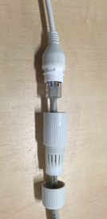

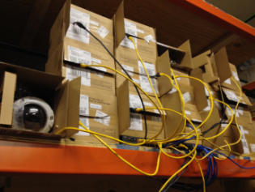
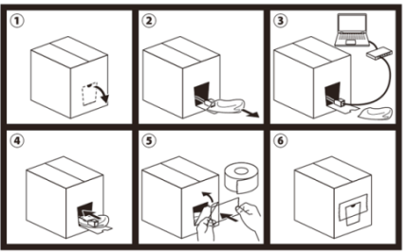
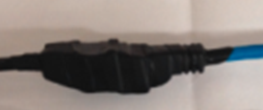

Easy Installation and Setting (WV-X4571L only)
Extreme
Simplicity
Installation time reduction by adopting “Easy Kitting Packing” and “RJ45 Joint Connector”
Easy Kitting Packaging Kitting work without removing from the box Kitting time reduced by 3 minutes | RJ45 Joint Connector Waterproof tape processing unnecessary Installation time reduce by 3 minutes
Taping for
waterproof
Rubber (2 pcs)
Current condition
X4571L
X4571LM

Slide 35
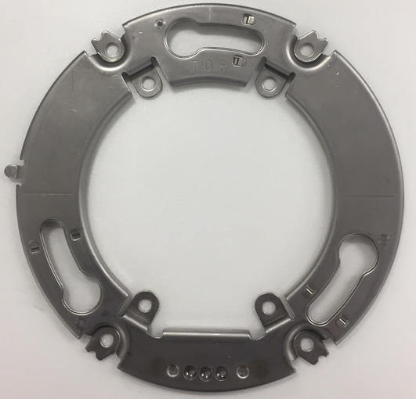
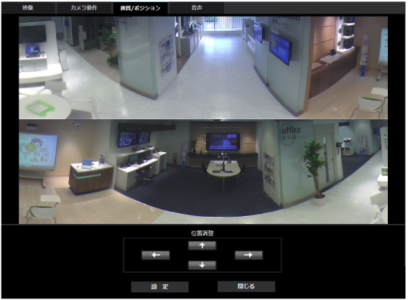
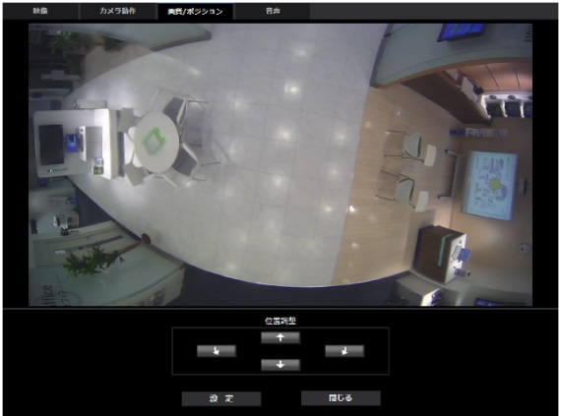

Other Features: Angular Field of View Adjustment
Extreme
Simplicity
Newly applied “Rotation Adjustment” by changing rotation position of bracket
Easy Rotation Adjustment
Angular Field of View Adjustment
New Attachment Bracket
Fixable in 3 position (-5, 0 and , +5 degree)
Double Panorama
Adjustable up and down, left and right
(Preset position setting)
Panorama
Adjustable up and down
(Preset position setting)
±5°
Single PTZ/Quad PTZ
Click & centering on live screen
Position selection on fish eye control screen
Fisheye
Adjustment is not required
* It is possible to attach the main body also to the conventional attachment metal fittings
X4171
X4571L

Slide 36
Key Features
Extreme Visibility
  Peripheral Resolution by Stereo projection lens
  Super Dynamic 108dB
  Built in IR-LED supports 10m (only WV-X4571L)
  iA (intelligent Auto)
  Support Various dewarp mode (as same as current 9M 360 deg. Camera)
Extreme Compression
  H.265 + Smart Coding
Extreme Data Security
  Secure communication by Symantec certificate
  FIPS 140-2 Level 1 compliant
Extreme Analytics
  New People Counting * ASE303W
  People Counting, Heat-map and MOR * SAE200
New 9M 360-deg. camera
WV-X4171/X4170
(Indoor)
WV-X4571L/X4171LM
(Outdoor Vandal with IR-LED)
Other Features
  IP66, IK10 support *WV-X4571L (Vandal Resistant Outdoor model)
  Anti-corrosion screw
  SD card error display
  Built in Dehumidifier
36

Slide 37
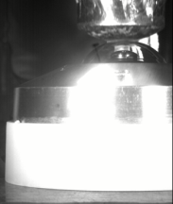
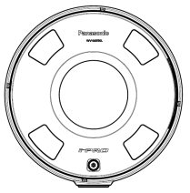
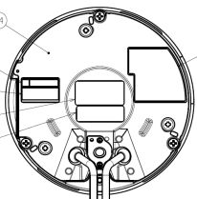
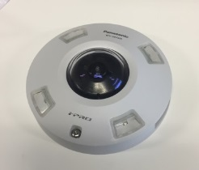
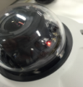
Other Features (WV-X4571L only)
Following Features of Conventional model and Extreme series
Vandal Roof *
Dehumidifier *
Anti-corrosion screw *
* Support WV-X4571L only
* Support WV-X4571L only
* Support WV-X4571L only
Impact resistance 50J/IK10 compatible
Dehumidifying element mounted
Adoption of Anti-corrosion screws prevents sticking due to corrosion and improves maintainability
SD Card Error Display *
* Support WV-X4571L only
SD card error display LED
Installed in LED lighting unit seen from the outside
When a warning status is detected Lights red
  SD memory card warning detection conditions:
  After the total use time has exceeded 6 years and the number of overwrite times has exceeded 2000.
When an error status is detected Blinks red
  SD memory card error detection conditions: Write error, read error, etc.
X4171
X4571L
37

Slide 38
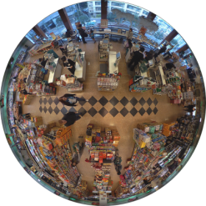
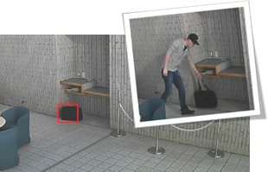
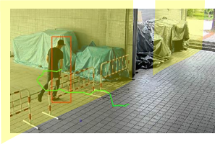
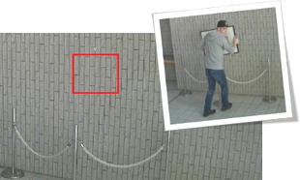
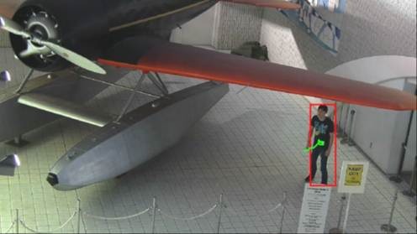


Other Features
Intelligent Motion detection is supported
i-VMD covering 360° wide area
Intruder detection
Detects people or cars trespassing in restricted areas.
Object detection (left)
Detects something left behind that shouldn’t be there.
Loitering detection
Detects people who has loitered for too long in the area.
Object detection (removed) Detects objects disappearing that should be present.
Scene change detection
Detects tampering with the camera view.
Cross line detection
Detects people or objects crossing the imaginary lines.
X4171
X4571L
Notes:
As first introduction of 4K cameras, we will launch 2 new 360 degree cameras;
One is WV-SFV481, outdoor vandal model, and the other is SFN480, indoor dome model.
The 3 major points are
ULTRA High Resolution 9M pixel as 360 degree camera
ULTRA High Sensitivity
ULTRA Intelligent

Slide 39



Other Features
Business intelligent function is supported
Business Intelligence in camera
People count
By counting people who cross up to 12 imaginary lines in the 360° wide view, the 360-degree cameras help business improve the physical layout and operational efficiency.
Heat map
By overlaying the traffic volume of people and staying time, the 360 degree cameras visualize the movement of people in the area.
Moving Object Remover (MOR)
The 360 degree cameras enable customer behavior analysis, keeping their privacy. Moving Object Remover (MOR) makes moving objects translucent.
X4171
X4571L
Notes:
As first introduction of 4K cameras, we will launch 2 new 360 degree cameras;
One is WV-SFV481, outdoor vandal model, and the other is SFN480, indoor dome model.
The 3 major points are
ULTRA High Resolution 9M pixel as 360 degree camera
ULTRA High Sensitivity
ULTRA Intelligent

Slide 40
Contents
Concept
Key features
      Extreme Visibility
      Extreme Compression
Image Capture mode
Supported Resolution
System Configuration
Specification Comparison
Bundled Items and Options
Model Number
Appearance
      Extreme Data Security
      Extreme Simplicity
      Other Features
40

Slide 41

Restriction of Super Dynamic
When “On” is set for Super Dynamic, maximum frame rate becomes 15 fps because of the sensor capability.
GUI alert
1. Image Adjust window
2. Stream setup window
When “Set” is clicked on the specified condition, pop-up alert will be shown
"Frame rate" will become "15fps" at a maximum since "On" is set for "Super Dynamic".
This message will be displayed to notice as restriction.
X4171
X4571L
X4170
X4571LM
41

Slide 42

Restriction of Super Dynamic
Manual (Operating Instruction)
(2.5.5.1 Configure the settings relating to image quality (“Image adjust” setup menu))
Please make a note this restriction.
X4171
X4571L
X4170
X4571LM
42

Slide 43

GUI: Back Focus Setting
Focus area setting
When performing back focus, you can use this frame to specify the subject on the screen for which the focus should be adjusted. Unless specified otherwise, adjusts the focus to the subject in the central area of the screen.
New
Adjusting method (X4571L)
Auto/Preset / Fix
Auto: Adjusts the back focus function automatically and corrects the focus when switching between color
and black & white images.
Preset: Performs the preset movement to each specified back focus position when switching between color and black & white images.
Fix: Fixes the position after adjusting the back focus either automatically or manually
X4171
X4571L
X4170
X4571LM
43

Slide 44

Image Capture Mode
Select image capture mode by setting position (Ceiling / Wall) and type
(Follow the specification of conventional camera)
[ Ceiling ] [ Wall ]
Fisheye
[ Ceiling ]
Double Panorama / Quad PTZ / Single PTZ / Fisheye + Double Panorama / Fisheye + Quad PTZ / Quad Stream
[ Wall ]
Panorama / Quad PTZ / Single PTZ / Fisheye + Panorama
Equivalent to WV-S4150
X4171
X4571L
X4170
X4571LM
44

Slide 45
Image Capture Mode Comparison
Support 30fps output in Fisheye, 15fps output in High Resolution De-warp mode.
Installation | WV-X4571L/X4171 New 9M 360-deg. | WV-S4550L/S4150 New 5M 360-deg. | WV-SFN480 Existing 9M 360-deg.
[ Ceiling ] [ Wall ] | Fisheye@30fps | Fisheye@30fps | 9M Fisheys@15fps 4M Fisheye@30fps
[Ceiling ] | Double Panorama / Quad PTZ / Single PTZ Fisheye + Double Panorama Fisheye + Quad PTZ / Quad Stream @15fps | Double Panorama / Quad PTZ / Single PTZ Fisheye + Double Panorama Fisheye + Quad PTZ / Quad Stream @30fps | Double Panorama@15fps Quad PTZ / Single PTZ@15fps 8M Fisheye + Double Panorama@7.5fps 4M Fisheye + Double Panorama@15fps 8M Fisheye + Quad PTZ@7.5fps 4M Fisheye + Quad PTZ@15fps Quad Stream@15fps
[ Wall ] | Panorama / Quad PTZ / Single PTZ Fisheye + Panorama @15fps | Panorama / Quad PTZ / Single PTZ Fisheye + Panorama @30fps | Panorama@15fps Quad PTZ / Single PTZ@15fps 8M Fisheye + Panorama@7.5fps 4M Fisheye + Panorama@15fps
X4171
X4571L
*Stream(2) of Quad stream mode is 5fps (Same as 9M camera)
X4170
X4571LM
45

Slide 46
Max. Resolution Comparison
The Max. output resolution is equivalent to the existing model
 | Image | WV-X4571L/X4171 New 9M 360-deg. |  | WV-S4550L/S4150 New 5M 360-deg. |  | WV-SFN480 (9M) Existing 9M 360-deg. |  | Remarks
 |  | JPEG | H.265/264 | JPEG | H.265/264 | JPEG | H.264
1 | Fisheye | 2992x2992 | 2992x2992 | 2192x2192 | 2192x2192 | 2992x2992 | 2992x2992
2 | Double Panorama Panorama | 2560x1440 | 2560x1440 | 1920x1080 | 1920x1080 | 2560x1440 | 2560x1440
3 | Quad PTZ Single PTZ | 2560x1920 | 2560x1920 | 1600x1200 | 1600x1200 | 2560x1920 | 2560x1920
X4171
X4571L
X4170
X4571LM
46

Slide 47
Supported Resolution (1/2)
 | Capture Image Mode | Stream (1) (H.265/ H.264) | Stream (2) (H.265/ H.264) | JPEG (1) | JPEG (2) | Max. fps
1 | Fisheye (Ceiling / Wall) | ■Fisheye 2992x2992 2192x2192 1280x1280 640x640 320x320 | ■Fisheye 1280x1280 640x640 320x320 | ■Fisheye 2992x2992 2192x2192 1280x1280 640x640 320x320 | ■Fisheye 1280x1280 640x640 320x320 | Stream:30fps JPEG: 5fps when using stream, and 15fps when not using stream.
2 | Double Panorama (Ceiling) | ■Double Panorama 2560x1440 1920x1080 1280x720 640x360 320x180 | ■Double Panorama 1920x1080 1280x720 640x360 320x180 | ■Double Panorama 2560x1440 1920x1080 1280x720 640x360 320x180 | ■Double Panorama 1920x1080 1280x720 640x360 320x180 | Stream:15fps JPEG: 5fps when using stream, and 15fps when not using stream.
3 | Panorama (Wall) | ■Panorama 2560x1440 1920x1080 1280x720 640x360 320x180 | ■Panorama 1920x1080 1280x720 640x360 320x180 | ■Panorama 2560x1440 1920x1080 1280x720 640x360 320x180 | ■Panorama 1920x1080 1280x720 640x360 320x180 | Stream:15fps JPEG: 5fps when using stream, and 15fps when not using stream.
4 | Quad PTZ (Ceiling / Wall) | ■Quad PTZ 2560x1920 2048x1536 1600x1200 1280x960 800x600 VGA QVGA | ■Quad PTZ 1280x960 800x600 VGA QVGA | ■Quad PTZ 2560x1920 2048x1536 1600x1200 1280x960 800x600 VGA QVGA | ■Quad PTZ 1280x960 800x600 VGA QVGA | Stream:15fps JPEG: 5fps when using stream, and 15fps when not using stream.
X4171
X4571L
X4170
X4571LM
47

Slide 48
Supported Resolution (2/2)
 | Capture Image Mode | Stream (1) (H.265/ H.264) | Stream (2) (H.265/ H.264) | JPEG (1) | JPEG (2) | Max. fps
5 | Single PTZ (Ceiling / Wall) | ■Single PTZ 2560x1920 2048x1536 1600x1200 1280x960 800x600 VGA, QVGA | ■Single PTZ 1280x960 800x600 VGA QVGA | ■Single PTZ 2560x1920 2048x1536 1600x1200 1280x960 800x600 VGA, QVGA | ■Single PTZ 1280x960 800x600 VGA QVGA | Stream:15fps JPEG: 5fps when using stream, and 15fps when not using stream.
6 | Fisheye + Double Panorama (Ceiling) | ■Fisheye 2992x2992 2192x2192 1280x1280 640x640, 320x320 | ■Double Panorama 1280x720 640x360 320x180 | ■Fisheye 2992x2992 2192x2192 1280x1280 640x640 320x320 | ■Double Panorama 1280x720 640x360 320x180 | Stream:15fps JPEG: 5fps when using stream, and 15fps when not using stream.
7 | Fisheye + Panorama (Wall) | ■Fisheye 2992x2992 2192x2192 1280x1280 640x640 320x320 | ■Panorama 1280x720 640x360 320x180 | ■Fisheye 2992x2992 2192x2192 1280x1280 640x640 320x320 | ■Panorama 1280x720 640x360 320x180 | Stream:15fps JPEG: 5fps when using stream, and 15fps when not using stream.
8 | Fisheye + Quad PTZ (Ceiling / Wall) | ■Fisheye 2992x2992 2192x2192 1280x1280 640x640 320x320 | ■Quad PTZ 1280x960 800x600 VGA QVGA | ■Fisheye 2992x2992 2192x2192 1280x1280 640x640 320x320 | ■Quad PTZ 1280x960 800x600 VGA QVGA | Stream:15fps JPEG: 5fps when using stream, and 15fps when not using stream.
9 | Quad Stream (Ceiling) | ■Single PTZ (Ch1-Ch4) 1280x960 800x600 VGA QVGA | ■Quad PTZ 2560x1920 2048x1536 1600x1200 1280x960, 800x600, VGA, QVGA |  |  | Stream (1) ⇒ 15fps -------------- Stream (2) ⇒ 5fps
X4171
X4571L
X4170
X4571LM
48

Slide 49
Bitrate Table (H.265)
* Please access to SSBD wiki for more details data.
http://10.75.24.156/en/index.php/h.265bitrate
Resolution | Image Quality | Frame Rate [fps]
 |  | 1 | 3 | 5 | 7.5 | 10 | 12 | 15 | 20 | 30
640x640 | XF | 384 | 512 | 512 | 512 | 512 | 640 | 640 | 768 | 768
 | SF | 256 | 384 | 384 | 384 | 384 | 448 | 448 | 640 | 640
 | FQ | 224 | 320 | 320 | 320 | 320 | 352 | 352 | 448 | 448
 | NQ | 128 | 256 | 256 | 256 | 256 | 256 | 256 | 384 | 384
1280x1280 | XF | 1280 | 1536 | 1536 | 1536 | 1536 | 1536 | 1536 | 2048 | 2048
 | SF | 768 | 1280 | 1280 | 1280 | 1280 | 1280 | 1280 | 1536 | 1536
 | FQ | 512 | 768 | 768 | 768 | 768 | 896 | 896 | 1024 | 1024
 | NQ | 384 | 512 | 512 | 512 | 512 | 768 | 768 | 768 | 768
2192x2192 | XF | 2048 | 3072 | 3072 | 3072 | 4096 | 4096 | 4096 | 6144 | 6144
 | SF | 1536 | 2048 | 2048 | 2560 | 3072 | 3072 | 3072 | 4096 | 4096
 | FQ | 1280 | 1536 | 1536 | 1792 | 2560 | 2560 | 2560 | 3072 | 3072
 | NQ | 1024 | 1280 | 1280 | 1536 | 1792 | 1792 | 1792 | 2560 | 2560
2992x2992 | XF | 4096 | 6144 | 6144 | 6144 | 7168 | 7168 | 8192 | 10240 | 10240
 | SF | 3072 | 4096 | 4096 | 5120 | 6144 | 6144 | 6144 | 8192 | 8192
 | FQ | 2560 | 3072 | 3072 | 3584 | 3584 | 3584 | 5120 | 6144 | 6144
 | NQ | 1792 | 2048 | 2048 | 2048 | 2560 | 2560 | 2560 | 3584 | 3584
* This table is valid only for group-10.
Unit: kbps
X4171
X4571L
X4170
X4571LM
49

Slide 50









System Configuration
Assume the same system configuration conventional 9M camera except for frame rate
[ Pattern 1 ]
Simultaneous delivery of high resolution fisheye images for recording and low resolution Fisheye for live
For Recording: Stream(1), 9M Fisheye, 30fps
Single PTZ / Quad PTZ
Panorama / Double Panorama
L3 Switch
Record
Playback
Compensation
VMS or NX series recorder
Confirm any place afterward
ASM300 / VMS
Live
Compensation
Quad PTZ / Panorama
Double Panorama
Arbitrarily select display pattern
Monitors
For Live: Stream(2), VGA Fisheye, 30fps
X4171
X4571L
X4170
X4571LM
50

Slide 51

System Configuration
Assume the same system configuration conventional 9M camera except for frame rate
[ Pattern 2 ]
Simultaneous delivery of high resolution fisheye images for recording and low resolution Quad PTZ for live
For Recording: Stream(1), 9M Fisheye, 30fps
Single PTZ / Quad PTZ
Panorama / Double Panorama
L3 Switch
Record
Playback
Compensation
VMS or NX series recorder
Confirm any place afterward
Live
ASM300 / VMS
Quad PTZ
Operation is similar with 4 fixed cameras
Monitors
For Live: Stream(2), Quad PTZ, 15fps
Framerate will be 15fps in case of Quad PTZ for live.
* 5M camera (WV-S4150/S4550L) will be 30fps.
X4171
X4571L
X4170
X4571LM
51

Slide 52


Spec. Comparison (Indoor Model) 1/2
Improvements from the existing model: iA, Super Dynamic, H.265, Framerate and Secure
Model No. | Existing 9M 360-deg. WV-SFN480 | New 9M 360-deg. WV-X4171 | New 9M 360-deg. WV-X4170 | 5M 360-deg. WV-S4150
Appearance
Image Sensor | 1/2" 9MP CMOS | 1/2" 9MP CMOS | 1/2" 9MP CMOS | 1/3" CMOS
Lens(focal length, F) | 1.4 / F1.9 | 1.4 / F1.9 | 1.4 / F1.9 | 0.84mm / F2.4
Minimum Illumination | 0.3 lx | 0.3 lx | 0.3 lx | 0.3 lx
Intelligent Auto | N/A | Yes | Yes | Yes
Super Dynamic, Dynamic Range | N/A, 84dB | YES, 108dB | YES, 108dB | YES, 108dB
Wide Dynamic Range | YES | YES (Next version up) | YES (Next version up) | N/A
IR-LED, irradiation distance | N/A | N/A | N/A | N/A
Angular Field of view | H 180°/V 180° | H 183°/V 183° | H 183°/V 183° | H/V 186°
Video Compression | H.264/ MJPEG | H.265/ H.264/ MJPEG | H.265/ H.264/ MJPEG | H.265/ H.264/ MJPEG
Image Resolution(max)/ Frame Rate(max) | 2992x2992 / 15fps | 2992x2992 / 30fps * Super Dynamic “On”: Max. 15fps | 2992x2992 / 30fps * Super Dynamic “On”: Max. 15fps | 2192x2192 / 30fps
Smart Coding | Yes | Yes | Yes | Yes
Audio Compression | G.726, G.711, AAC-LC | G.726, G.711, AAC-LC | N/A | G.726, G.711, AAC-LC
Security standard | N/A | FIPS140-2 Level1 | FIPS140-2 Level1 | FIPS140-2 Level1
X4171
X4170
52

Slide 53
Spec. Comparison (Indoor Model) 2/2
Model No. | Existing 9M N/A360-deg. WV-SFN480 | New 9M 360-deg. WV-X4171 | New 9M 360-deg. WV-X4170 | 5M 360-deg. WV-S4150
Appearance
Power Source | DC12V, PoE(class0) | DC12V, PoE(class0) | DC12V, PoE(class0) | DC12V, PoE(class2)
Ambient Operating Temperature | -10～+50℃ | -10～+50℃ | 0～+40℃ | -10～+50℃
External I/O Terminals | 3 | 3 | N/A | 3
Built in Mic | Yes | Yes | N/A | Yes
Mic (Line) Input | Yes | Yes | N/A | Yes
Audio Output | Yes | Yes | N/A | Yes
Water and Dust Resistance | N/A | N/A | N/A | N/A
Shock Resistance | N/A | N/A | N/A | N/A
Dimensions | φ150 x 52.1mm | φ150 x 49.5mm | φ150 x 49.5mm | φ150 x 50.5mm
Mass (approx.) | 480g | 420g | 420g | 390g
VMD, People count, etc. | Yes | Yes | Yes | Yes
New People count | N/A | Yes | N/A | Yes
Tripod screw | Yes | Yes | N/A | Yes
X4171
X4170
53

Slide 54


Spec. Comparison (Outdoor Model) 1/2
Improvements from the existing model: iA, IR-LED, Super Dynamic, H.265, Framerate and Secure
Model No. | Existing 9M 360-deg. WV-SFV481 | New 9M 360-deg. WV-X4571L/X4571LM | 5M 360-deg. WV-S4550L
Appearance
Image Sensor | 1/2" 9MP CMOS | 1/2" 9MP CMOS | 1/3" CMOS
Lens(focal length, F) | 1.4 / F1.9 | 1.4 / F1.9 | 0.84 / F2.4
Minimum Illumination | 0.3 lx | 0.3 lx | 0.3 lx
Intelligent Auto | N/A | Yes | Yes
Super Dynamic, Dynamic Range | N/A, 84dB | Yes, 108dB | Yes, 108dB
Wide Dynamic Range | YES | YES (Next version up) | N/A
IR-LED, irradiation distance | N/A | Yes, 10m (When Intensity control is “ON”) | Yes, 10m (When Intensity control is “ON”)
Angular Field of view | H 180°/V 180° | H 183°/V 183° | H/V 186°
Video Compression | H.264/ MJPEG | H.265/ H.264/ MJPEG | H.265/ H.264/ MJPEG
Image Resolution(max)/ Frame Rate(max) | 2992x2992 / 15fps | 2992x2992 / 30fps * Super Dynamic “On”: Max. 15fps | 2192x2192 / 30fps
Smart Coding | Yes | Yes | Yes
Audio Compression | G.726, G.711, AAC-LC | G.726, G.711, AAC-LC | G.726, G.711, AAC-LC
Security standard | N/A | FIPS140-2 Level1 | FIPS140-2 Level1
X4571L
X4571LM
54

Slide 55

Spec. Comparison (Outdoor Model) 2/2
Improvements from the existing model: Ambient Operating Temperature
Model No. | Existing 9M 360-deg. WV-SFV481 | New 9M 360-deg. WV-X4571L/X4571LM | 5M 360-deg. WV-S4550L
Appearance
Power Source | DC12V, PoE(class0) | DC12V, PoE(class0) | DC12V, PoE(class0)
Ambient Operating Temperature | -40～+50℃ | -40～+60℃ | -40～+60℃
External I/O Terminals | 3 | 3 | 3
Built in Mic | N/A | N/A | N/A
Mic (Line) Input | Yes | Yes | Yes
Audio Output | Yes | Yes | Yes
Water and Dust Resistance | IP66 | IP66 | IP66
Shock Resistance | 50J, IK10 | 50J, IK10 | 50J, IK10
Dimensions | φ164 x 96.5mm (When using Base Bracket) | φ164 x 96.3mm (When using Base Bracket) | φ164 x 96.3mm (When using Base Bracket)
Mass (approx.) | 1.3kg (When using Base Bracket) | 1.3kg (When using Base Bracket) | 1.3kg (When using Base Bracket)
X4571L
X4571LM
55

Slide 56
Other function list
No | Function |  | 9MP SFN480 | Fixed Dome S2131L | 5MP S4150 | New 9MP X4571 | Note
1 | Video transmittance | Smart Coding (GOP control) | Yes Off/Low/Mid/ High | Yes Off/Low/Mid/ Advanced | Yes Off/Low/Mid/ Advanced/ Frame rate control | Yes Off/Low/Mid/ Advanced/ Frame rate control
2 |  | Smart Coding (Auto VIQS) | Yes | Yes | Yes | Yes
3 |  | Face Smart Coding | N/A | Yes | N/A | N/A
4 |  | Number of video stream | 2 | 4 | 2 | 2
5 |  | Stream priority | Yes | N/A | N/A | N/A
6 |  | VIQS (Fixed area setting) | Yes (8 area) | N/A | Yes (8 area) | Yes (8 area)
7 |  | Decode (ActiveX) | Software (Fixed) | Software (Fixed) | Hardware /Software *selectable | Hardware /Software *selectable | When selecting hardware, Intel Core i5-6500, Intel Core i7-6700 is required for PC spec.
8 |  | Stream Shaping | N/A | Yes Default: Off | Yes Default: On | Yes Default: On | Countermeasure for packet loss by burst
9 |  | Number of simultaneous access users | 14 | 14 | 14 | 14
X4171
X4571L
X4170
X4571LM
56
Notes:
288kmph= カトリーナ：280 km/h
伊勢湾台風=270km/h

Slide 57
Other function list
No | Function |  | 9MP SFN480 | Fixed Dome S2131L | New 5MP S4150 | New 9MP X4571 | Note
10 | Analytics | Motion detection (VMD) | Yes | Yes | Yes | Yes
11 |  | Video Analytics (i-VMD) | Yes | Yes | Yes | Yes | SAE200
12 |  | Video Analytics (Heat map, people count, MOR) | Yes | N/A | Yes | Yes | SAE200
13 |  | New people count | N/A *Project base | N/A | Yes | Yes | SAE303W Not support for MP version. Will be updated by firmware version up
14 |  | Face detection | N/A | Yes | N/A | N/A
15 | SD recording | The number of recording stream | 1stream | 2stream | 1stream | 1stream
 |  | Password lock | N/A | N/A -> Yes | N/A | Yes | Will be updated by firmware version up
16
17 | Rotation adjustment (Fisheye) |  | +/- 45 deg. by mechanical | N/A | -5, 0, +5 deg. by attachment plate | -5, 0, +5 deg. by attachment plate
18 | Rotation adjustment (Panorama) |  | +/- 45 deg. by mechanical and 90 deg. by software | N/A | -5, 0, +5 deg. by attachment plate | -5, 0, +5 deg. by attachment plate
19 | Rotation adjustment (Double Panorama) |  | +/- 45 deg. by mechanical and 90 deg. by software | N/A | as above + by software | as above + by software
X4171
X4571L
X4170
X4571LM
57
Notes:
288kmph= カトリーナ：280 km/h
伊勢湾台風=270km/h

Slide 58


Bundled Items
  ■ WV-X4171
No. | Item | Q’ty
1 | Installation Guide | 1 pc.
2 | Important Safety Instructions | 1 pc.
3 | Warranty card | 1 pc.
4 | CD-ROM *2 | 1 pc.
5 | Code label *3 | 1 pc.
6 | Attachment Plate | 1 pc.
7 | Audio Cable*4 | 1 set
8 | Power cord plug*4 | 1 pc.
9 | External I/O terminal plug | 1 pc.
10 | Template A(for Attachment Plate) | 1 pc.
11 | Cable tie | 2 pc.
12 | Safety wire lug | 1 pc.
13 | Safety wire | 1 pc.
14 | Washer | 1 pc.
15 | Spring washer | 1 set
  ■ WV-S4571L
No. | Item | Q’ty
1 | Installation Guide | 1 set
2 | Important Safety Instructions | 1 pc.
3 | Warranty card *1 | 1 set
4 | CD-ROM *2 | 1 pc.
5 | Code label *3 | 1 pc
6 | Base Bracket | 1 pc
7 | Attachment Plate | 1 pc
8 | Fixing screws for attachment plate | 5 pc
9 | Template A (for the attachment Plate) | 1 pc.
10 | Template B (for base bracket) | 1 pc
11 | Waterproof tape | 1 pc
12 | 4P alarm Cable | 1 pc
13 | 2P power Cable | 1 pc
14 | Bit (Hex wrench, screwsize6.35mm{1/4inches}T20 | 1 pc
15 | RJ45 Waterproof connecter cover | 1 pc
16 | RJ45 Waterproof connecter cap | 1 pc
*1 This product comes with several types of warranties. Each warranty is only applicable to the products purchased in the regions indicated on the relevant warranty.
*2 The CD-ROM contains the operating instructions and different kinds of tool software programs.
*3 This label may be required for network management. Use caution not to lose this label.
*4 The power cord plug is attached to the camera.
*5 The screws are necessary when installing the camera on a separately sold mount bracket.
X4171
X4571L
X4170
X4571LM
58

Slide 59








Options
  ■ Mount Bracket and Attachment Pipe
WV-X4170/X4171
WV-X4571L
1. WV-Q121B (Silver)
Ceiling Mount Bracket
2. WV-Q122A (Silver)
Wall Mount Bracket
1. WV-Q105A
Ceiling Mount Bracket
3. WV-Q124 (Silver)
Mount Bracket
4. WV-Q185 (Light gray)
Wall Mount Bracket
6. WV-Q123
Pipe Mount Bracket
(For Japan only)
2. WV-Q180
Indoor Mount Bracket
(For X4171 only) (For Japan only)
5. WV-Q186 (Light gray)
Mount Bracket
X4171
X4571L
X4170
X4571LM
59

Slide 60
Model Number
Model Name | Model Number
9M 360-deg. Indoor Camera | WV-X4171/X4170
9M 360-deg. Outdoor Camera | WV-X4571L/X4571LM
W | V |  | X | 4 | 1 | 7 | 1/0
W | V | - | X | 4 | 5 | 7 | 1 | L | M
 |  |  | Series | Form | Environment | Resolution | Serial number | Other features |  | Minor Change | Region (J/H)
 |  |  | X:X series High - end S:S series High specification & High cost performance V:V series Price competiveness | 9：- 8：Multi sensor 7：PTZ(Aero) 6：PTZ(Dome) 5：PT 4：360 deg. 3：Compact DOME 2：Dome 1：Box 0 : - | 9：- 8：- 7：- 6：- 5：Outdoor Vandal 4：Outdoor normal 3：- 2：Indoor Vandal 1：Indoor normal 0：- | 9：- 8 :6K(24MP) 7 :4K (12MP) 6 : 5 :5MP 4： 3 :FHD 2 : 1 :HD 0 :- | 9 : 8 : 7 : 6 : 5 : 4 : 3 : 2 : 1 : 0： | L : LED N: Rain wash coating (Non Raindrop) M: M12 W: Wireless F : Optical I/F V : With lens T : Long focal lens K : Fix lens |  | D : C : B : A :
Reserve
3rdgen.
2nd gen.
1st gen.
X4171
X4571L
X4170
X4571LM
60

Slide 61


Appearance (WV-X4171/X4170)
Dimensions: Φ150 x 49.5 mm (H)
Weight: Approx.420g
X4171
X4170
61

Slide 62


Appearance (WV-X4571L/X4571LM)
Dimensions: Φ164 x 96.3 mm (H)
Weight: Approx.1.3 kg with Base
Approx.880g with Attachment
X4571L
X4571LM
62

Slide 63
PC specification for 9M 360 deg. camera
Since 9M pixel is high resolution, High performance PC also be required for display.
Necessary PC specification (It is same specification with ASM300 rest of Graphic accelerator)
  Follow specification as below.
  Use smooth buffering mode on camera browser.
  Use Hardware decode function on camera browser.
    For H.265 Hardware decoding, at least one monitor should be connected to onboard Graphics as a main display.
  Use display port Ver.1.2.
System requirements
CPU | Intel® Core™ i7-6700 or faster
Memory | - 8GB or more - Using the dual channel corresponding memory, it is the memory of the same performance and requires the use of in pairs. (e.g.：In the case of 8GB, use 2pcs of 4GB memory)
Graphic accelerator | - VRAM: 512MB or more, compatible with Microsoft® DirectX® 9.0c or later - Using 4K display, it requires NVIDIA Quadro P600 especially for 9M pixel 30fps monitoring. Without the Graphics board, it is necessary to use FHD display or 9M 15fps setting.
OS | Microsoft® Windows® 10 64bit
X4171
X4571L
X4170
X4571LM
63

Slide 64


GUI: Easy Setup
Internet
Event action
Easy Setup
The “Easy Setup” page uses simple operations to set the following:
Internet setup:
  Make the camera image available on the Internet
Event action setup:
  Set event actions such as recording of a schedule/alarm to the SD memory card
X4171
X4571L
X4170
X4571LM
64

Slide 65


GUI: Decoding option / Audio out
Basic (Basic menu)
■Decoding option
Software / Hardware
Software: Decoded by software.
Hardware: Decoded by using hardware acceleration (QSV / DXVA) function with high speed.
New!!
Note: When the bit rate is higher than 2192x2192, 30fps, 8Mbps, please use Hardware decoding. (Recommended PC specification: Intel Core i7-6700 or faster processor, OS type: In case of H.265: Use Windows 10, In case of H.264: Use Windows 7 or later)
Confirm button
Possible to confirm whether the using PC can support Hardware decoding. (Following three judgement)
Possible to use Hardware decoding for both H.265 and H.264.
Possible to use Hardware decoding for H.264 only.
Impossible to use Hardware decoding
New!!
Audio out
Audio / Monitor
Audio: Use as Audio output
Monitor: Use as monitor output
Change!!
Note: Can be used monitor output regardless image capture mode.
(WV-SFV481/SFN480 is available monitor output when selecting Fisheye mode only.)
Note: If the PC is not suitable for Hardware decoding, the following message will be displayed.
X4171
X4571L
X4170
X4571LM
65

Slide 66

GUI: SD memory card (X4571L/X4571LM only)
SD memory card warning / error LED
Select On/Off to determine whether or not to activate the SD memory card warning/error LED when an SD memory card warning or error is detected.
SD memory card warning / error LED
Off / On
On: When a warning status is detected, the SD memory card error/error LED turns on. When an error status is detected, the SD memory card error/error LED starts flashing.
Off: Stops detection of warning or error status.
Note:
SD memory card warning detection conditions: After the total use time has exceeded 6 years and the number of overwrite times has exceeded 2000.
When recognition error and warning occur at the same time, recognition error display (blinking) is made.
Flashing cycle is 500 msec. on, 500 msec. off
Caution:
When using "SD memory card warning / error lamp" ON, the SD memory card warning / error lamp may appear in the image in the surrounding environment etc.
X4571L
X4571LM
66

Slide 67
GUI: Image Adjust (Basic menu)
Basic Menu
Dynamic range
Off/ On(Super Dynamic)
Light control mode
ELC/ Indoor scene(50Hz) / Indoor scene(60Hz)
Day & Night (electrical) (S4150,X4171 only)
Off/ Auto
Day & Night (S4550L,X4571L only)
Off/ On(IR Light Off)/ On(IR Light On)/ Auto1(IR Light Off)/
Auto2(IR Light On)/ Auto3(SCC)
White balance: ATW1/ ATW2/ AWC
Intelligent auto: On/ Off
Detailed setting
Scene registration
Change!!
X4171
X4571L
X4170
X4571LM
67

Slide 68


GUI: Image Adjust (Super Dynamic)
Dynamic range
Dynamic range
Off/ On(SuperDynamic) / On(Wide dynamic range)
Level: 0 to 31 Super Dynamic level setting (Default: 28)
BLC / HLC
Off/ Back light compensation(BLC) / High light compensation(HLC)
*Default is Off: Deactivates the back light compensation function and high light compensation function.
Note: When “On” is selected for “Super Dynamic(SD)” or when “On” is selected for “Intelligent Auto”, this setting is not available.
BLC level: 0 to 31 level setting (Default: 16)
HLC level: 0 to 31 level setting (Default: 16)
Mask area
12x12
Note: When “On” is selected for “Super Dynamic(SD)”, this setting is not available.
Regardless of the “Image capture mode” setting, Fisheye images are configured for mask settings.
IMPORTANT: The mask area may move out of alignment if the setting for “Image capture mode” of the [Image] tab
or “Upside-down” of the [Basic] tab is changed after the mask area has been configured. Make sure to check the mask area after changing the “Image capture mode” setting.
Change!!
On(スーパーダイナミック)設定時は、フレームレートが最大15fpsに
制限されます
12
Can be set more finely than previous 9M 360-deg camera (WV-SFN480) (8x8)
12
Change!!
X4171
X4571L
X4170
X4571LM
68

Slide 69

GUI: Image Adjust (Light control mode)
Light control mode
Light control mode
ELC/ Indoor scene(50Hz) / Indoor scene(60Hz)
*The shutter speed will automatically be adjusted to prevent flicker caused by fluorescent light. Select 50 Hz or 60 Hz corresponding to the location where the camera is in use.
Brightness: 0 to 255 (Default: 64)
Maximum gain: 0 to 11 (Default: 9)
* When the luminance of the subject becomes darker, gain will be automatically increased and screen will become brighter. If you increase the gain, the noise may also increase.
Maximum shutter
Max.1/10000s, Max.1/4000s, Max.1/2000s, Max.1/1000s, Max.1/500s, Max.1/250s, Max.1/120s, Max.1/100s, Max.2/120s, Max.2/100s, Max.3/120s, Max.1/30s, Max.2/30s, Max.4/30s, Max.6/30s, Max.10/30s, Max.16/30s
(There are total 17 patterns available, Default: Max 1/30s)
Light control speed: 0 ～ 31 (Default: 16)
X4171
X4571L
X4170
X4571LM
69

Slide 70

GUI: Image Adjust (Day & Night)
Day & Night
X4571L/X4571LM GUI
X4171/4170 GUI
Day & Night (electrical) (S4150)
Off/ Auto
Off: The color mode is selected.
Auto: Switches from color to black-and-white images when the ambient brightness (illuminance) of the camera is approx. 1.0 lx or less. It takes time to switch between modes.
Day & Night (S4550L)
Off/ On(IR Light Off)/ On(IR Light On)/ Auto1(IR Light Off)/ Auto2(IR Light On)/ Auto3(SCC)
*Default is Auto2(IR Light On): The camera automatically switches between the color mode and the black & white mode in accordance with the picture brightness (luminance). Suitable when using near-infrared lighting at night.
Level: High/ Low
Dwell time: 2s/ 10s/ 30s/ 1min
IR LED light intensity: High/ Middle / Low
Intensity control: On / Off
Change!!
X4171
X4571L
X4170
X4571LM
70

Slide 71

GUI: Image Adjust (White balance)
White balance
White balance
ATW1/ ATW2/ AWC
Note:
Under the following conditions, color may not be faithfully processed. In these cases, select “AWC”.
  - When shooting a subject whose major part is a thick color
  - When shooting blue sky or sun at sunset
  - When shooting a subject whose luminance is too low
When “AWC” is selected, click the [Set] button.
Red gain
0 to 255 level setting (Default: 128)
Blue gain
0 to 255 level setting (Default: 128)
Mask area
12x12
Adjustment speed
0 to 31 level setting (Default: 16)
Can be set more finely than previous 9M 360-deg camera (WV-SFN480) (8x8)
Change!!
X4171
X4571L
X4170
X4571LM
71

Slide 72


GUI: Image Adjust (Intelligent auto / Scene registration)
Intelligent auto
Intelligent auto
On/ Off
Motion priority level
0 to 255 level setting (Default: 128)
“Intelligent Auto” can detect conditions (back lighting, outdoor, night time, etc.) or moving objects and then automatically adjust the camera’s aperture, gain, shutter speed, and contrast in order to display moving objects more clearly.
Change!!
Note: “Face priority” is not applied 5MP 360-deg. camera
Scene registration
Scene file
1: Scene 1, 2: Scene 2, 3: Scene 3, 4: Scene 4 (up to 4 files can be registered)
Scene file title
The scene file name (up to 10 characters) displayed in “Scene file” can be changed. Only file names displayed in “1:”, “2:”, “3:”, and “4:” can be changed.
* Unavailable characters: " &
[Load] button: Loads the setting data selected in “Scene file” and changes the current image accordingly.
[Register] button: The combination of settings used to adjust image quality that are currently displayed can be registered to the scene file displayed in “Scene file”.
X4171
X4571L
X4170
X4571LM
72

Slide 73

GUI: Image Adjust (Detailed setting)
Detailed setting
Auto contrast adjust
On/ Off(Manual)
Contrast level
0 to 255 level setting (Default: 128)
Adaptive black stretch
0 to 255 level setting (Default: 128)
Adaptive highlight stretch
0 to 255 level setting (Default: 128)
Fog compensation
On/ Off
Level
0 to 127 level setting
Chroma gain level
0 to 255 level setting (Default: 128)
Hue level
0 to 255 level setting (Default: 128)
Aperture level
0 to 31 level setting (Default: 16)
Pedestal level
0 to 255 level setting (Default: 128)
DNR
0 to 255 level setting (Default: 128)
New
New
New
The following three functions have been newly added to WV-S4150/4550L, which 9M 360-deg camera does not support.
Auto contrast adjust: Select On/Off(Manual) to determine whether or not to activate the auto contrast adjust function.
Adaptive highlight stretch: Adjust the brightness of the bright parts of the image.
Fog compensation: The fog compensation function can make dim images that have been affected by fog or other conditions clearer using digital image processing.
Note: When “On” is selected for “Auto contrast adjust”, or when “On” is selected for “Intelligent Auto”, this setting is not available.
X4171
X4571L
X4170
X4571LM
73

Slide 74

GUI: Encoding format / Transmission priority
Image tab on Image/Audio menu
Stream encoding format
H.265 / H.264
* The stream encoding format can be selected for stream 1 and 2 respectively, such as Stream 1 as H.265, stream 2 as H.264.
Transmission priority
Frame rate / Constant bit rate / VBR / Best effort
Note:
Default setting of the Transmission priority has been changed to unified in the same as other Extreme series cameras.
When “Frame rate” is set for “Transmission priority”, number of users who can access the camera may be limited.
Change!!
X4171
X4571L
X4170
X4571LM
74

Slide 75
GUI: Smart coding (GOP control / Auto VIQS)
Image tab on Image/Audio menu
GOP control
Can be reduced data amount in areas where there is no motion. Available mode is different depends on encoding format.
A) In case of H.265 is selected
Off / On(Low) / On(Mid)/ On(Advanced)/ On(Frame rate control)
B) In case of H.264 is selected
Off / On(Low) / On(Mid)
Off:
On(Low): I frame interval: 1 to 8 sec.
On(Mid): I frame interval: 4 to 16 sec.
On(Advanced): I frame interval: 60 sec.
On(Frame rate control):
  By dynamically controlling the frame rate in addition to the refresh interval depending on the presence or absence of motion, the bit rate at the time of scene shooting without motion is further reduced.
Auto VIQS
Keeps high image quality in the motion area and suppresses the amount of data in other areas.
Off /On
New!!
New!!
X4171
X4571L
X4170
X4571LM
75

Slide 76

GUI: Audio
Audio input / Audio transmission
Audio input
Mic select (S4150 only)
Mic input volume
AGC (audio)
Audio bit rate
* Common use for both recording and transmission
Audio transmission
Setup relating audio transmission
Audio transmission mode
Mic input interval (Camera to PC)
Audio output volume (PC to Camera)
Audio output interval (PC to Camera)
Audio output duration
Audio output port (PC to Camera)
Audio input encoding format
X4171
X4571L
X4170
X4571LM
76

Slide 77




GUI: Alarm
Select functions to be activated by cause of alarm:
E-mail notification (per destination) / FTP transmission / SD recording
Alarm image FTP transmission
Alarm E-mail notification
For alarm FTP and alarm recording, it is also possible to select which alarm to operate
Alarm image recording(SD memory card)
It is possible to select which alarm to notify by e-mail for each e-mail notification destination.
X4171
X4571L
X4170
X4571LM
77

Slide 78

GUI: Alarm E-mail notification
E-mail subject / E-mail body / Terminal name
E-mail subject
There are two options
Use the camera title
Cause of alarm
Discrimination of sender and cause of alarm discrimination can be done only by mail title.
E-mail body
There are two options
Cause of alarm
Occurrence time
Terminal name
Describe terminal name when the alarm is occurred.
X4171
X4571L
X4170
X4571LM
78

Slide 79

GUI: User auth.
User name registration / Access level
User name registration
“--New registration--” will be displayed when clicking pulldown menu
When clicking pulldown menu, registered user name will be displayed
Up to 23 users can be registered
Note:
When "- new registration -" is selected, "change" and "delete" are grayed out.
When "Registered" user name is selected, "Change" and "Delete" become effective.
When “- new registration –”” is selected, register as new user name.
When “Change” is selected, Information on the selected user name is displayed in "User name" "Access level". The rest is the same as new registration.
When “Delete” is selected, the selected user is deleted..
Access level
Possible to change from the pulldown menu.
There are three options are selectable.
1. Administrator
2. Camera control
3. Live only
X4171
X4571L
X4170
X4571LM
79

Slide 80

GUI: Data encryption
Data encryption (User mng. menu)
Data encryption (Batch change)
On / Off
On : Encrypt data and distribute it
The password is required to open Live stream and
setting screen which is including video distribution.
Off : No data encryption
Change!!
Note:
It can not be used when the imaging mode is Quad stream.
Only AAC-LC is encrypted for Audio.
When encryption is set, the recording data is also encrypted.
Previous 9M 360-deg camera (WV-SFN480) does not have this function.
X4171
X4571L
X4170
X4571LM
80

Slide 81

GUI: Schedule
Schedule mode
Schedule mode
There are total 14 patterns are available
Off
Alarm permission (Terminal alarm 1, 2, 3)
Alarm permission (Terminal 1)
Alarm permission (Terminal 2)
Alarm permission (Terminal 3)
VMD permission
Access permission
H.264 recording
Image adjust 1: Scene 1
Image adjust 2: Scene 2
Image adjust 3: Scene 3
Image adjust 4: Scene 4
FTP periodic image transmission
E-mail permission
Note
When “Quad stream” is selected for “Image capture mode”, “FTP periodic image transmission”
cannot be selected.
X4171
X4571L
X4170
X4571LM
81

Slide 82
Thank you

